Slide 1
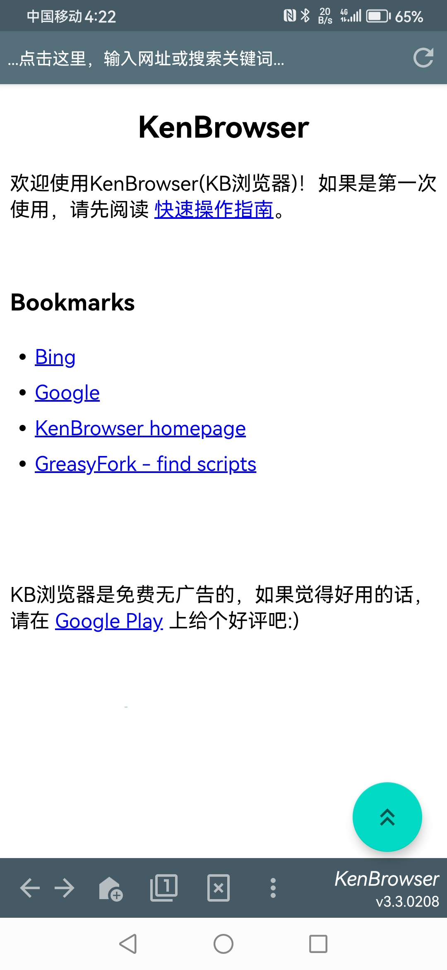
干净小巧
只有4m大小
无广告，无注册，专注浏览

Slide 2
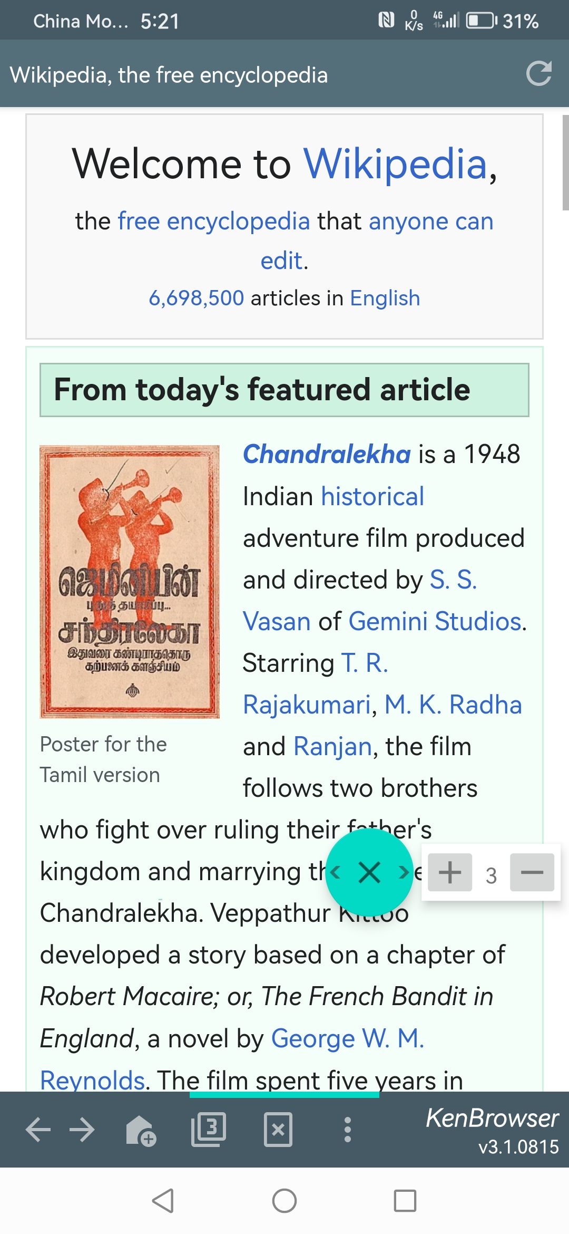

最少手指移动
网页自动滚动，可调速
最简操作，最少手指移动
浮动按钮：
单击： 向上滚动半屏
双击： 自动滚动网页
长按： 拖动移动按钮
划动： 上下左右翻屏
轻触按钮并向上下左右划出按钮边界，触发网页的上下左右翻屏
自动滚动时可调速
负值反向滚动

Slide 3
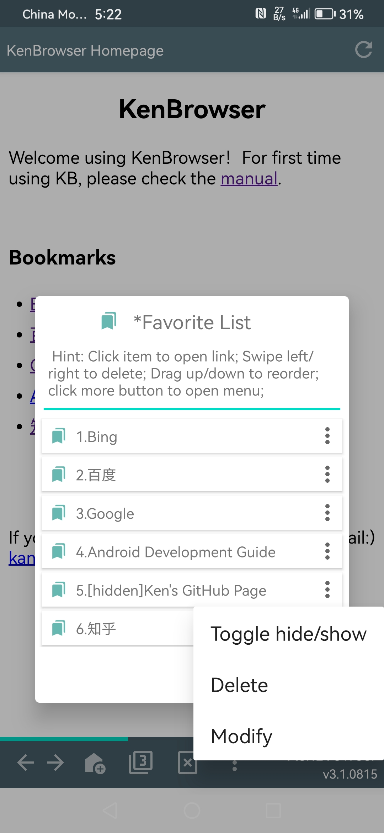
隐藏书签
可以隐藏你的个人书签
双击书签标题栏显示隐藏的书签
双击显示隐藏的书签
隐藏书签显示时，快捷菜单项可改变显示属性

Slide 4
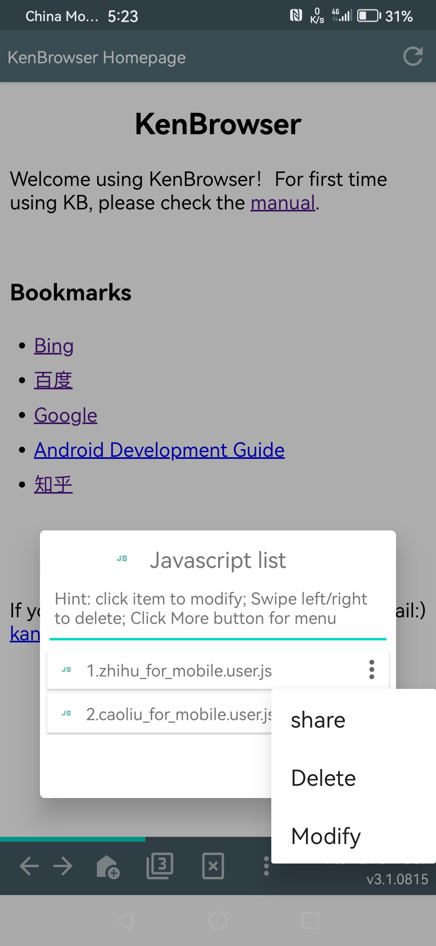
支持脚本注入
支持油猴脚本

Slide 5
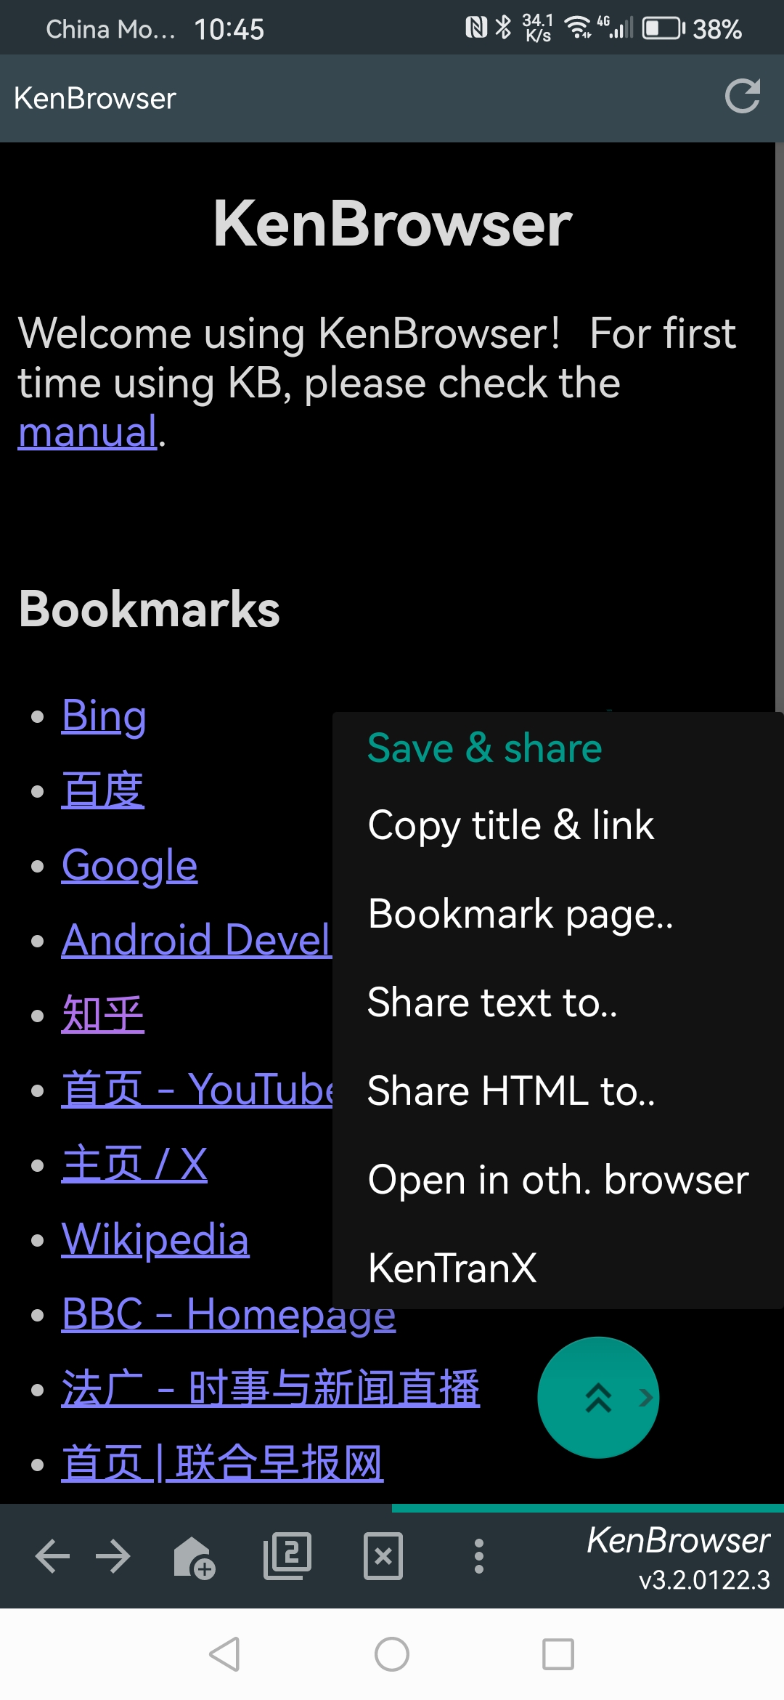
暗夜模式 &
强大分享功能

Slide 6
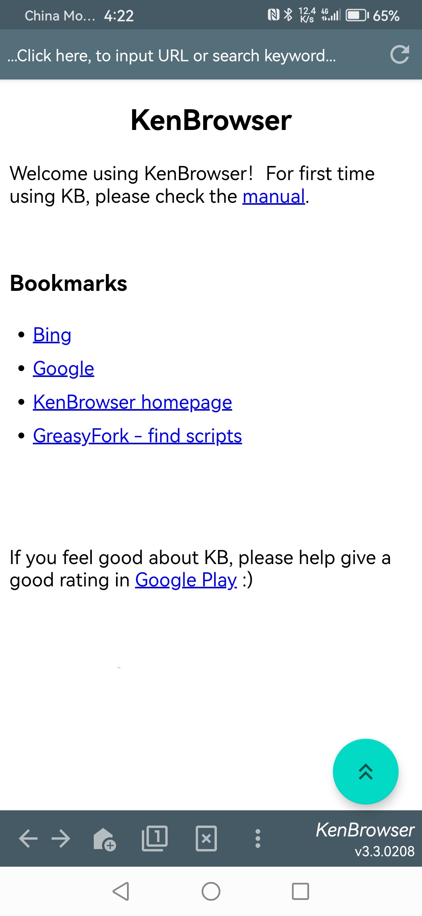
Tiny and Clean
Only 4m size
No ad, pure browsing

Slide 7
Finger Friendly
Webpage auto scroll
Least finger movement
Floating button:
Click: scroll up
Double-click: auto-scroll
Long-click: drag & move
Swipe-out: swipe page
Touch & swipe out of the button boundary, trigger page swipe.
Scroll speed adjustable

Slide 8
Hide Bookmarks
Hide your private bookmarks
Double-click the title to show hidden bookmarks
双击显示隐藏的书签
When showing hidden bookmarks, click to toggle status

Slide 9
Inject Javascript
Support TamperMonkey scripts

Slide 10
Night Mode &
Powerful ShareTo

Slide 11
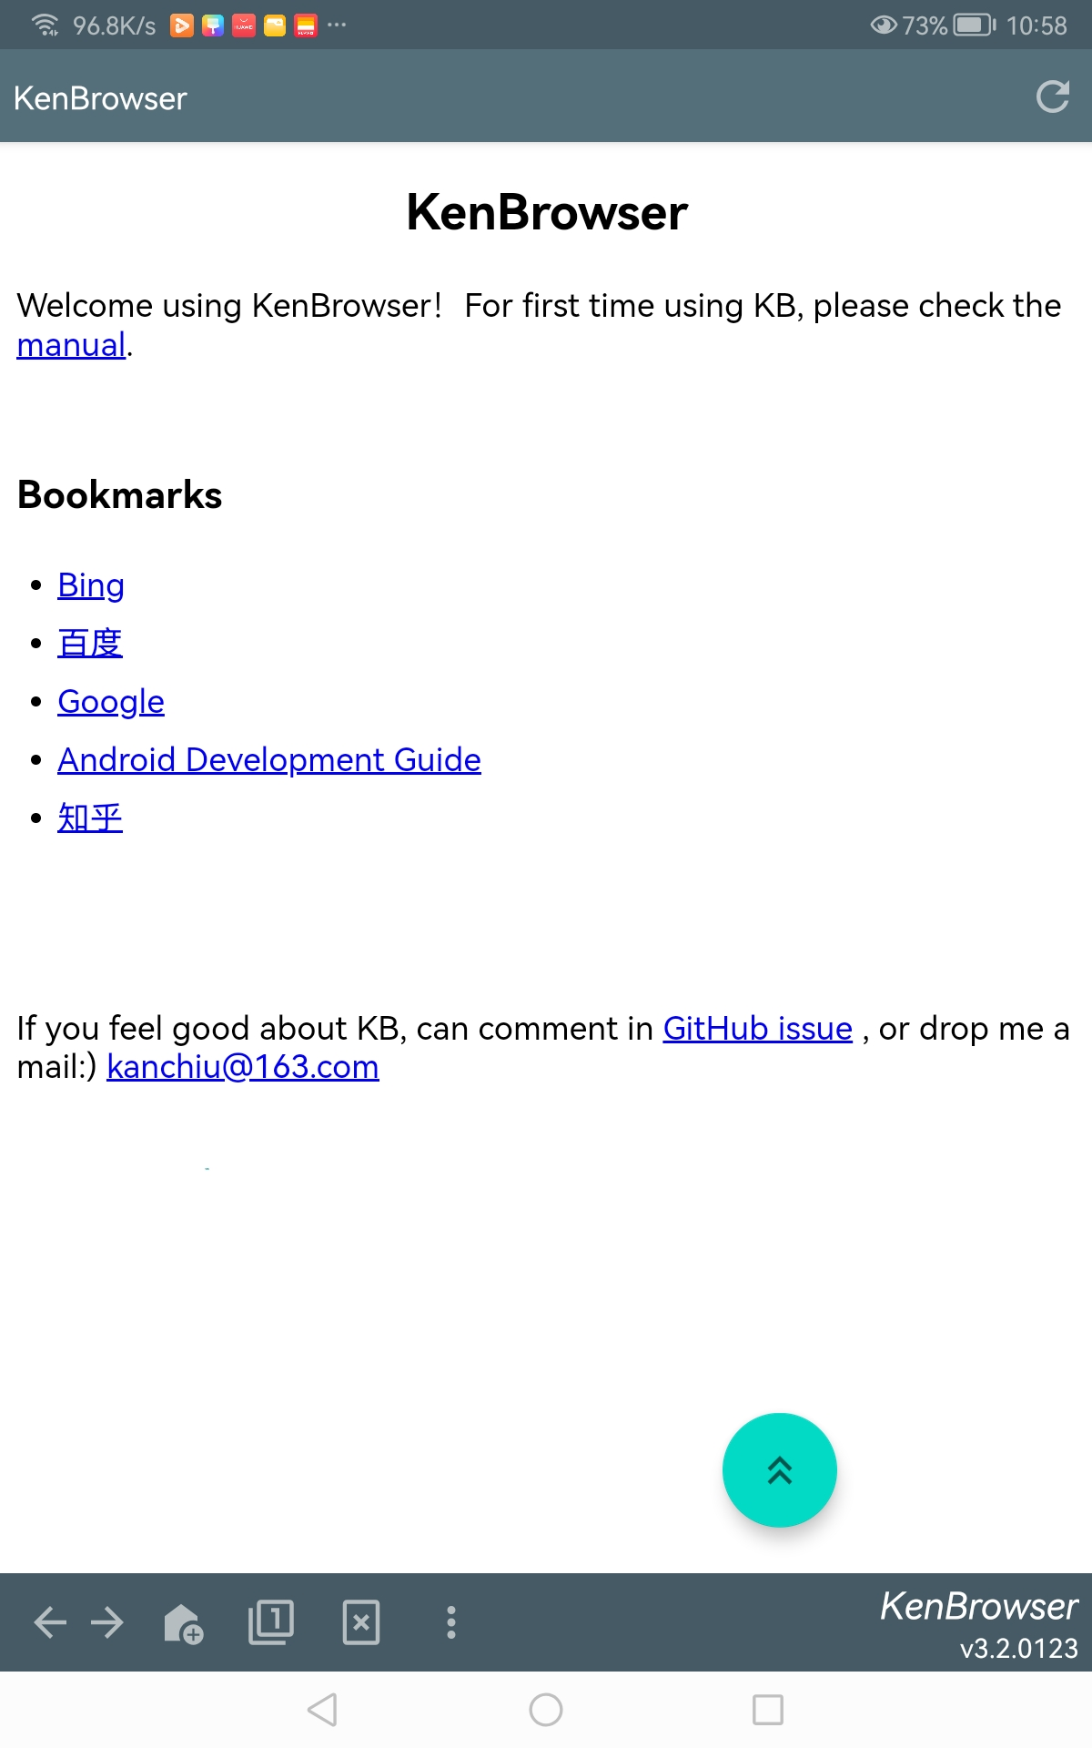
Tiny and Clean
Only 4m size
Ad-free, pure browsing

Slide 12
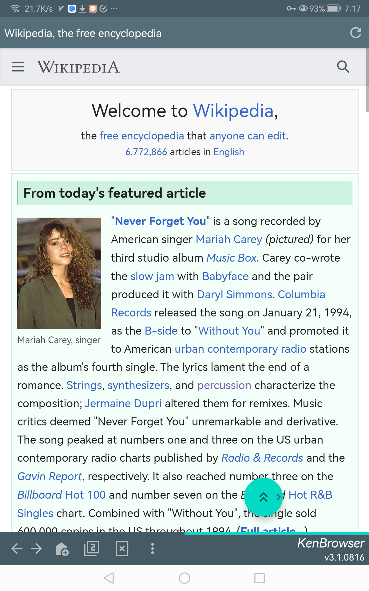
Finger Friendly
Webpage auto scroll
Least finger movement
Floating button:
Click: scroll up
Double-click: auto-scroll
Long-click: drag & move
Swipe-out: swipe page
Touch & swipe out of the button boundary, trigger page swipe.

Slide 13
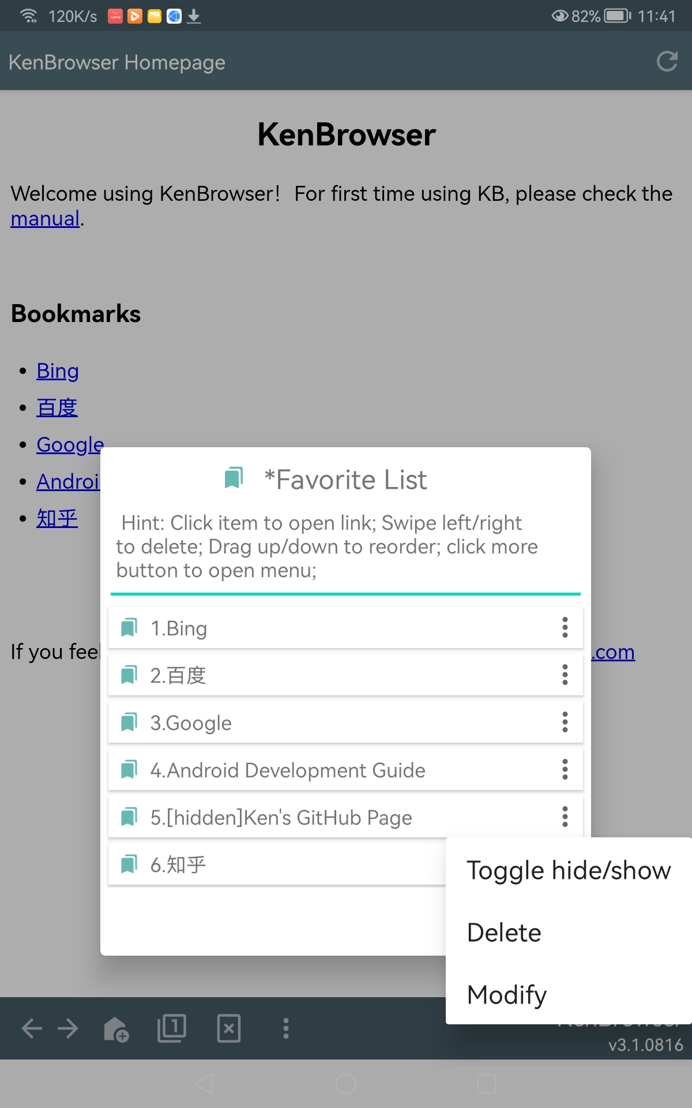
Hide Bookmarks
Hide your private bookmarks
Double-click the title to show hidden bookmarks
双击显示隐藏的书签
When showing hidden bookmarks, click to toggle status

Slide 14
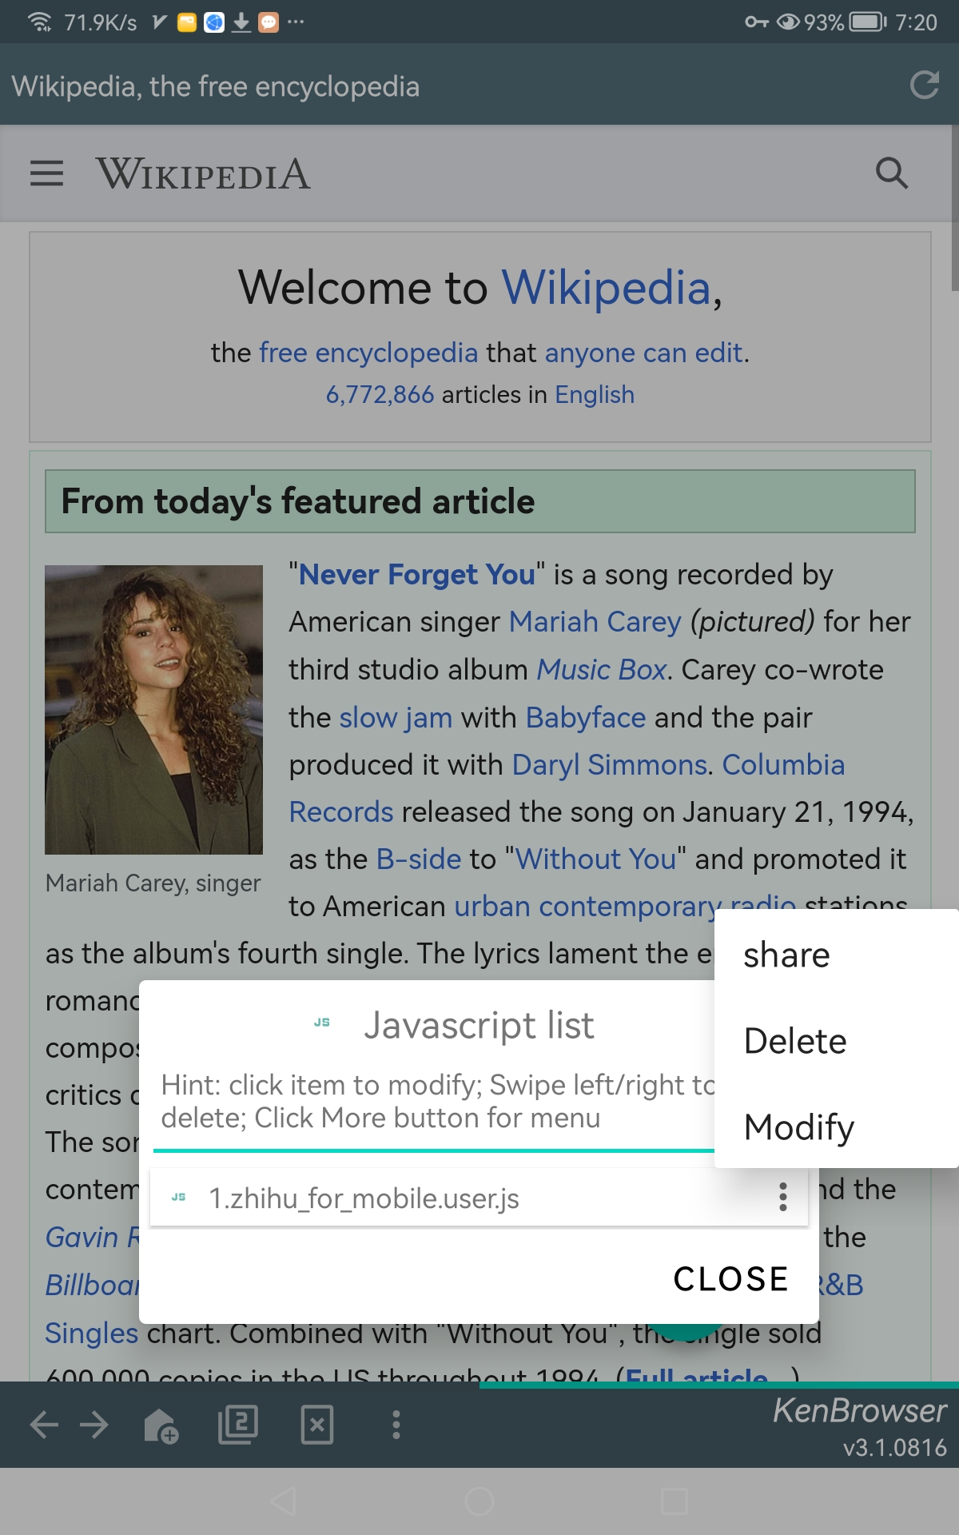
Inject Javascript
Support TamperMonkey scripts

Slide 15
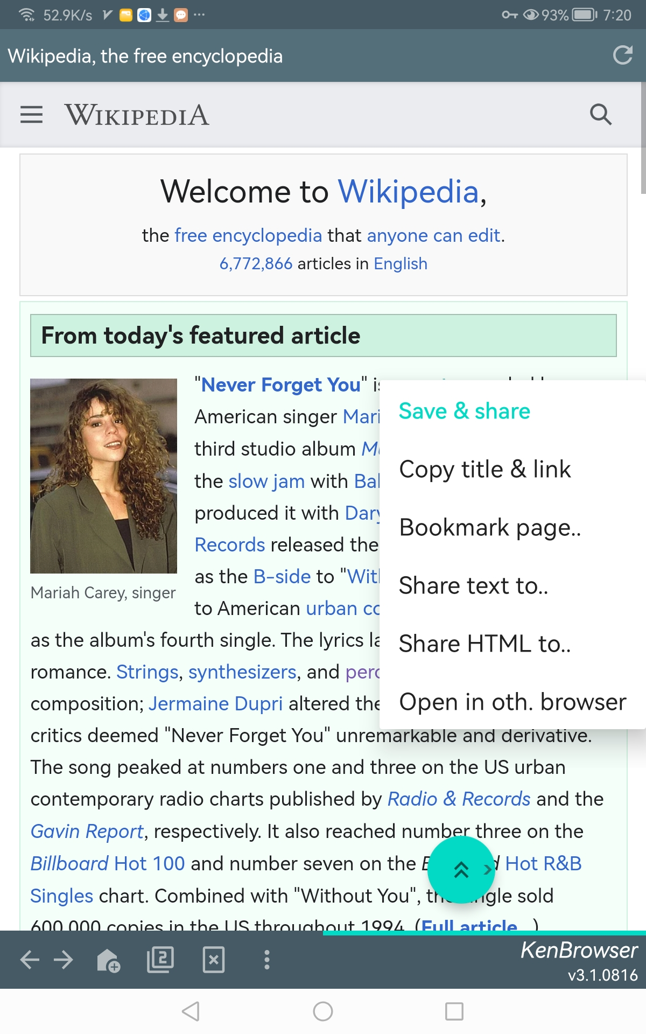
Powerful ShareTo

Slide 16
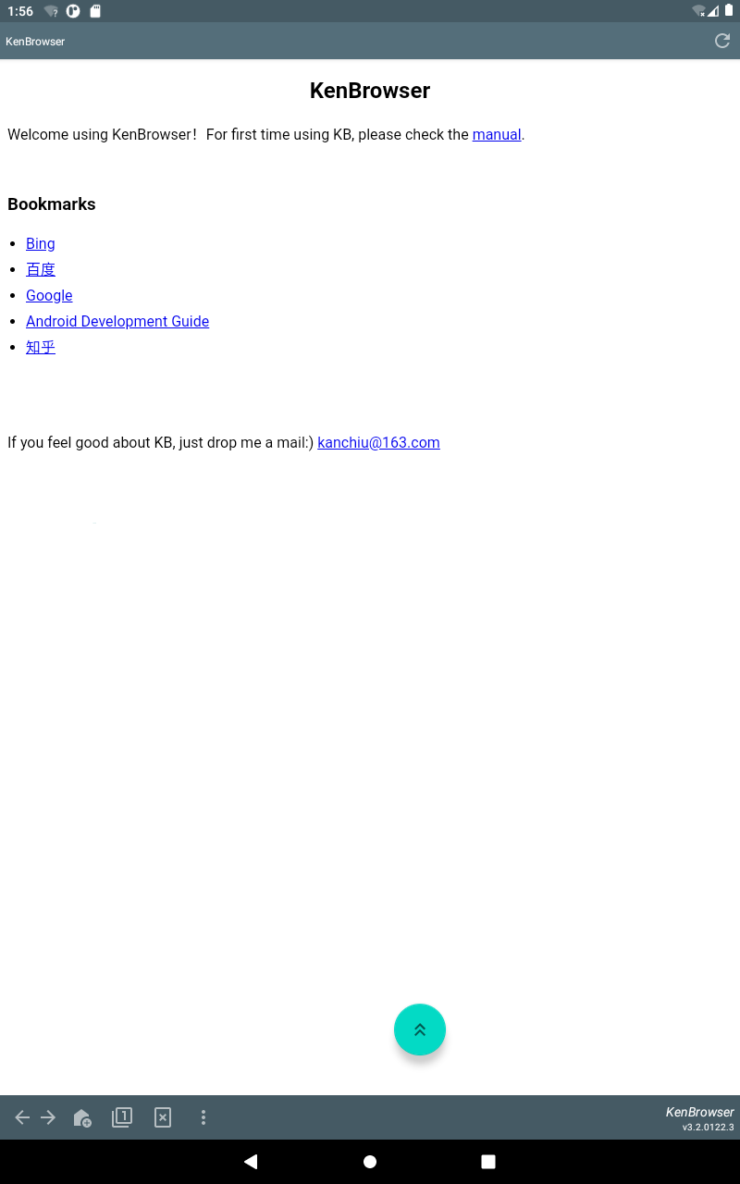
Tiny and Clean
Only 4m size
Ad-free, pure browsing

Slide 17
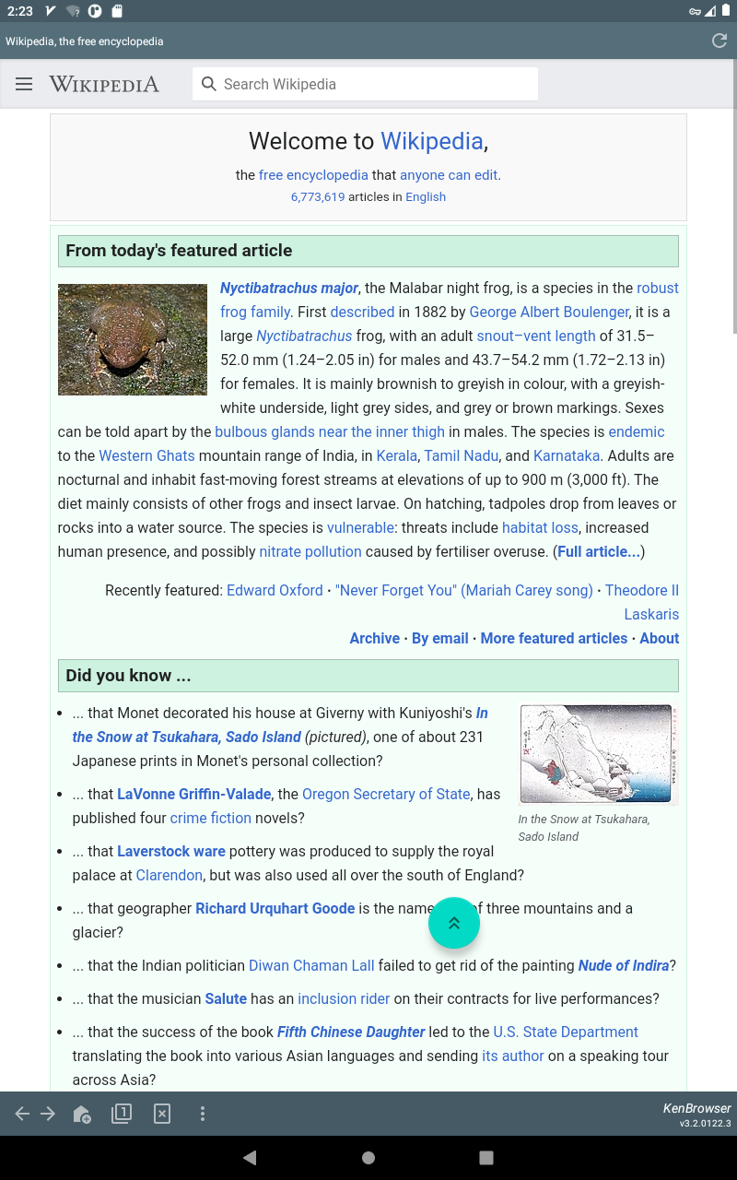
Finger Friendly
Webpage auto scroll
Least finger movement
Floating button:
Click: scroll up
Double-click: auto-scroll
Long-click: drag & move
Swipe-out: swipe page
Touch & swipe out of the button boundary, trigger page swipe.

Slide 18
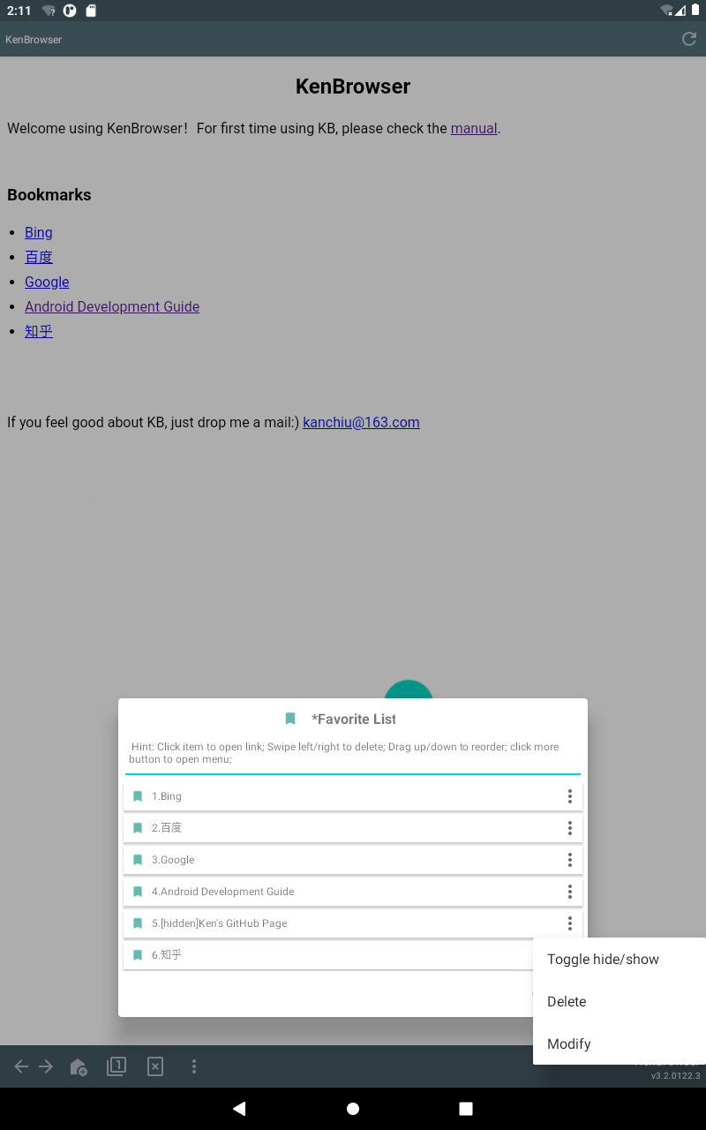
Hide Bookmarks
Hide your private bookmarks
Double-click the title to show hidden bookmarks
双击显示隐藏的书签
When showing hidden bookmarks, click to toggle status

Slide 19
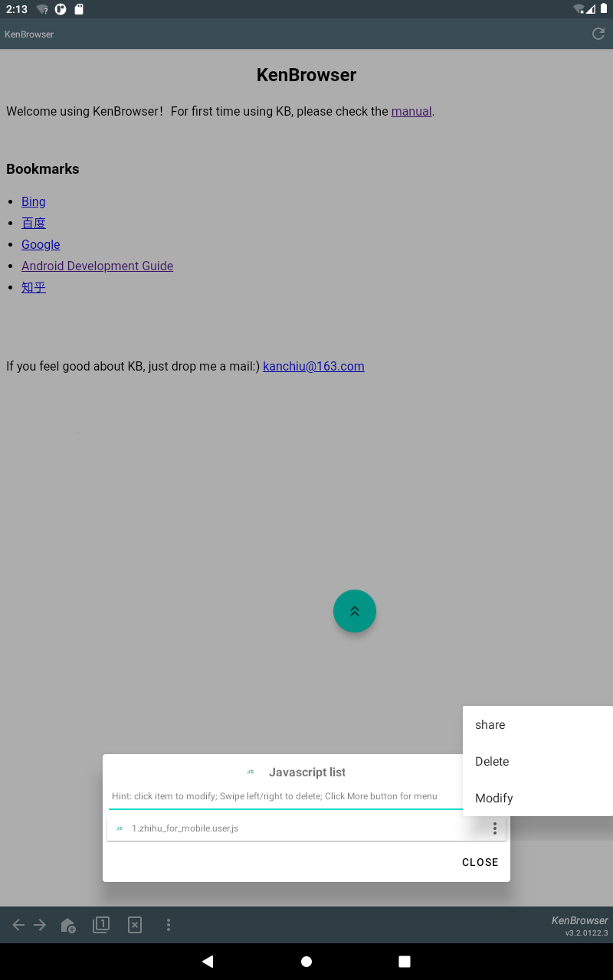
Inject Javascript
Support TamperMonkey scripts

Slide 20
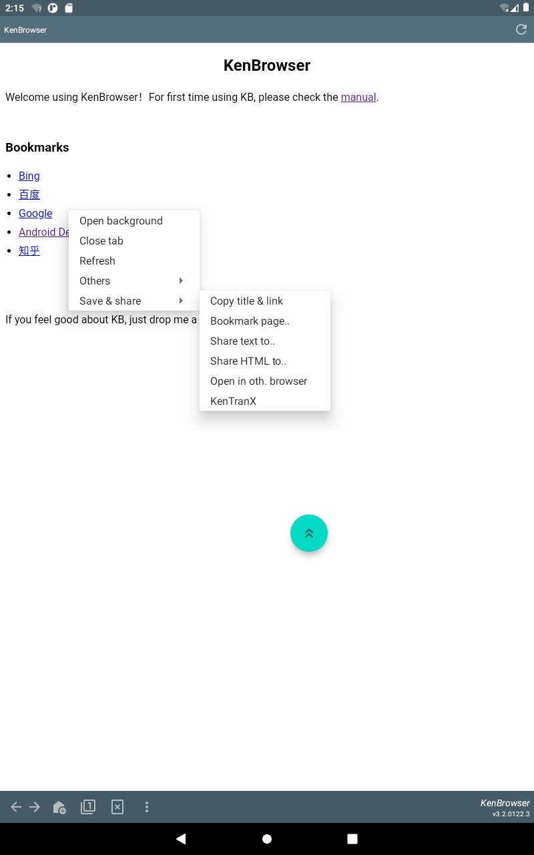
Powerful ShareTo

